Slide 1
Sprint 4
By Jack Berkowitz, Devin Brattvet, and John Cheema

Slide 2
Challenges
The biggest was Covid-19
Not being able to go into the course room
Unable to meet in person
Family gatherings we could not avoid
Time was limited on space provided
Materials were not found or provided

Slide 3
Our Roles
Jack B - head programer and tester for the robot, project manager
Devin B - design document planer and writer
John C - flowchart and algorithm creator, also provided more help on certain parts if needed

Slide 4
What We Learned About Software Engineering
- It is not as easy as it looks in the movies
- You have to be precise with the programing
- How to work with a group
- To pay close attention to detail in every step of the process
- It takes a team effort
- Communication is key

Slide 5
What We Would Do Differently
-Try to communicate more with the group
- Test our programs more times than needed see if errors occur
- Organize our data better
- Make in-person meetings if COVID-19 did not exist

Slide 6
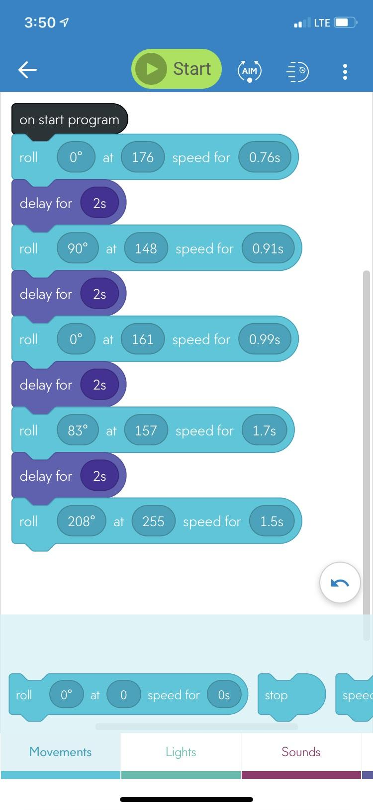
Sprint 3 Block Code

Slide 7

Video of Sprint 3

